Slide 1
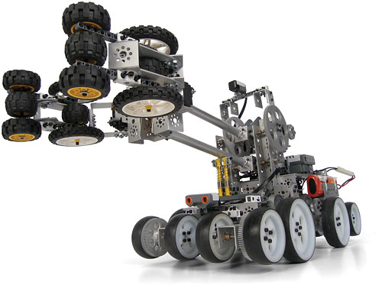
Robot Theatre Research at PSU

Slide 2
Hough Transform
for Radiation Therapy
Intelligent
Robotics
Zhao, Hun
PCA
for facial emotions
Labunsky
Emotional Robot
Lukac
Computer
Vision
Constructive Induction
Architecture with Perception of emotions
Gebauer
Labunsky
Computational
Intelligence
Emotion Based Motion
Generation
Sunardi
Common Robot Language for Humanoids
Lukac
Motion Generation
Evolutionary generation
of robot motions
Raghuvanshi
Robot theatre

Slide 3
Robot
Design : three theatres
The Narrator
Sonbi the Confucian Scholar
Interactive Hahoe Theatre
Of Large Robots
KHR-1
Pune the Courtisane
KHR-1
iSOBOT
Paekchong the Butcher
Improvisational
Musical of small robots
iSOBOT
The orchestra
The hexapod dancers

Slide 4
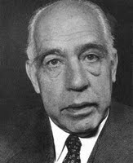
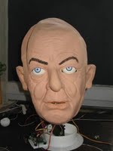
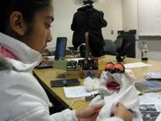

Physics Debate Theatre of medium robots
Dr. Niels Bohr
Schroedinger Cat
Professor Albert Einstein

Slide 5
What is robot theatre?

Slide 6
Theory of Robot Theatre?
Motion Theory:
  Motions with symbolic values
Theory of sign
  Creation of scripts, generalized events, motions
  to carry meaning
Robot theories that may be used:
  Machine Learning
  Robot Vision
  Sensor Integration
  Motion: kinematics, inverse kinematics, dynamics
  Group dynamics
  Developmental robots

Slide 7
Realizations of Robot Theatres
Animatronic “Canned” Robot theatre of humanoid robots
  Disneyworld, Disneyland, Pizza Theatre
Theatre of mobile robots with some improvisation
  Ullanta 2000
Theatre of mobile robots and humans
  Hedda Gabler , Broadway, 2008
  Phantom in Opera, 2008
  Switzerland 2009

Slide 8
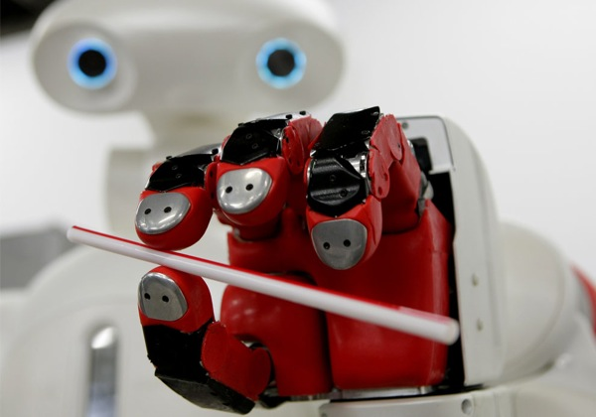
Models of Robot Theatre

Slide 9
Animatronic Theatre
Actors: robots
Directors: none
Public: no feedback
Action: fixed
Example: Disney World

Slide 10
controller
Robot
Canned code
Editor
Motion language
motion
controller
Robot

Slide 11
Inverse
Kinematics
Forward
Kinematics
Motion Capture
Editor
Motion language
motion
controller
Robot
Evolutionary Algorithms
A very sophisticated system can be used to create motion but all events are designed off-line.
Some small feedback, internal and external, can be used, for instance to avoid robots bumping to one another, but the robots generally follow the canned script.

Slide 12
Universal Event Editor
Motion Capture
Inverse
Kinematics
Forward
Kinematics
Robots
Events language
Lighting
System
Initial events
Universal Event
Editor
events
controller
Sound System
script
Curtain and all equipment

Slide 13
Universal Editors for Robot Theatre

Slide 14
Universal Perception Editor
Principal Component
Analysis
Neural Nets
cameras
Speech input
Constructive
Induction
Various Feature
Extracting
Methods
Sensors
Clustering
Perception Editor
Examples – input output pairs

Slide 15
Feedback from the environment
controller
Robot
The environment includes:
  Other robots
  Human actors
  Audience
  The director
controller
Robot
Critic

Slide 16
Interaction Theatre
Actors: robots
Directors: none
Public: feedback
Action: not fixed
Example: Hahoe

Slide 17
Behavior Learning Architecture for Interaction Theatre
Motion
Machines
Perception Machines
Output text _{i}
Input text from keyboard
Face Detection and Tracking
Output speech _{i}
Face Recognition
Behavior Machine
Output robot motion _{i}
Facial Emotion Recognition
Hand gesture recognition
Output lights _{i}
Sonar, infrared, touch and other sensors
Output special effects _{i}
Speech recognition
Output sounds _{i}

Slide 18
Improvisational Theatre
Actors: robots
Directors: humans
Public: no feedback
Action: not fixed
Example: Schrödinger Cat

Slide 19
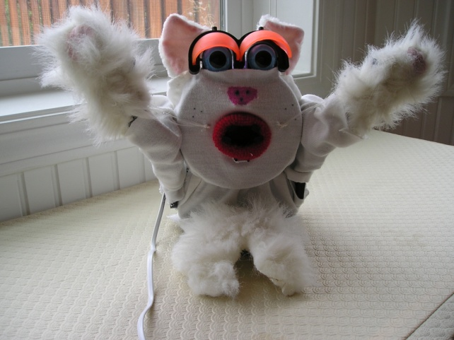
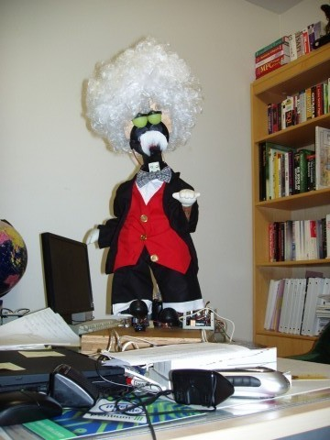
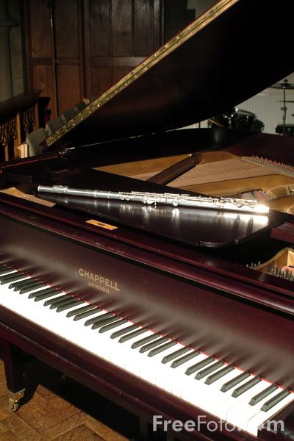
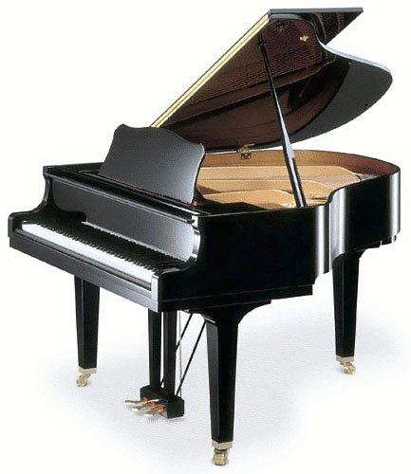
Improvisational Theatre “What’s That? Schrödinger Cat”
Schrödinger Cat
Professor Einstein
Motion _{e1}
Motion _{c1}
Motion _{e2}
Motion _{c1}
Motion _{cm}
Motion _{en}
Motions of Schrödinger Cat
Siddhar
Motions of Einstein
Arushi

Slide 20
Theatre of Robots
and Actors (contemporary)
Actors: robots
Actors: humans
Directors: humans
Public: traditional feedback, works only for human actors
Action: basically fixed, as in standard theatre

Slide 21
Theatre of Robots
and Actors (future)
Actors: robots
Actors: humans
Directors: humans + universal editors
Public: traditional feedback, like clapping, hecking, works for both robot and human actors
Action: improvisational, as in standard improvisational theatre

Slide 22
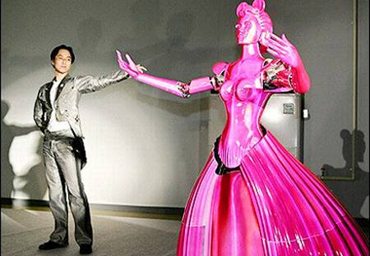

Slide 23
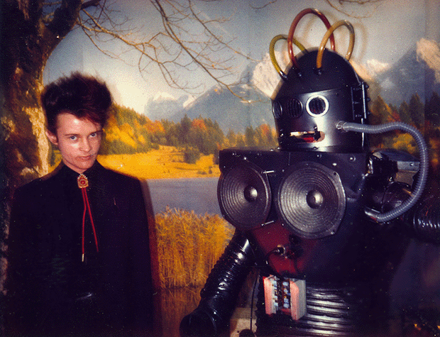
Research Topics in Robot Theatre

Slide 24
Perception
Face Recognition as a learning problem
Face Image 1
John Smith
Face Image 2
Face Image 3
Marek Perkowski
Face Image 4

Slide 25
Face Emotion (Gesture) Recognition as a learning problem
Face Emotion Recognition as a learning problem
Face Image 1
happy
Face Image 2
Face Image 3
sad
Face Image 4
Face
person

Slide 26
Recognition Problems = Who? What? How?
Face
person
Face
emotion
Face
age
Face
gender
Face
gesture
Learning problems in Human-Robot Interaction – Perception problems

Slide 27
Motion
Motion Problems = examples of correct motions – generalize and modify, interpolate
Mouth Motion
text
Hexapod walking
Distance evaluation
Biped walking
Number of falls
evaluation
Biped Gestures
Comparison to video evaluation
Hand gestures
Subjective human evaluation
Learning problems in Human-Robot Interaction – Motion Generation problems

Slide 28
The concept of generalized motions and universal event editor to edit:
  robot motions,
  behaviors,
  lightings and automated events

Slide 29
Languages to describe all kinds of motions and events
Labanotation
DAP (Disney Animation Principles) and
CRL (Common Robot Language)

Slide 30
Theory of Event Expressions
Tool to design motions directly from symbols.
This theory is general enough to allow arbitrary motion to be symbolically described but is also detailed enough to allow the designer or the robot to precise the generated behavior to the most fundamental details.
Our main concept is that the motion is a sequence of symbols, each symbol corresponding to an elementary action such as shaking head for answering “yes”.
We will call them primitive motions.
The complex motions are created by combining primitive motions.

Slide 31
What are the factors of motion that are important to generation of symbolic motions, especially in dance and pantomime?
The research issues are:
  (1) What should be the primitive, basic or atomic motions?
  (2) What should be the operations on motions that combine primitive motions to complex motions?
  (3) How symbolic motions are reflected/realized as physical motions of real robots?
  (4) How to create existing and new symbolic motions automatically using some kind of knowledge-based algebraic software editor.

Slide 32
Human-robot emotion-augmented communication systems.
The new extended communication media in addition to:
  speech
  will include prosody
  facial gestures
  hand gestures
  body language
    head and neck,
    legs,
    bending of full body,
    muscle-only motions
  The gestures used in daily communication,
  ritual gestures of all kinds,
  theatric and
  dance motions
will be captured or translated to certain algebraic notations.

Slide 33
the same grammar.
The unified notations will allow also to transform between various media.
For instance, a captured motion of a flower can be presented as motion of a pantomime actor.
A sound pattern can be transformed to a pattern of colored laser lights.
Sound, light, theatric stage movements, special effects and robot motions have all the same nature of sequences of symbolic event-related atoms.
Thus the theater itself becomes a super-robot with the ability to express its emotional state through various motions, lights and theater plays orchestration.
These sequences can be uniformly processed.
We propose to create universal editors that will be not specialized to any particular medium or robot.
They will use algebraic and logic based notations.

Slide 34
on-line versus off-line creation of motions
Film is an art that does not require feedback from the audience and every presented event is always exactly the same.
  Creation has been done earlier, off-line with the director and his associates as the audience during shooting and editing.
In contrast, the theatre performance is always slightly different and it depends on the feedback from the audience.
The public may say “Actor X had a good day today”.
The research questions are:
  (1) “will the future robot theatre be more similar to films or theatrical performances?”,
  (2) “can one create a realistic robot theatre without viewer’s feedback?”
  (3) “What type of tools do we need to create a theater play off-line versus on-line?”,
  (4) “Is an off-line sequence generator enough to create art?”
  (5) “Do we need a sequence generator and a virtual reality simulator before actuate the play on the robot”?
  (6) “How really important is the feedback from the audience for a human singer or conference speaker to modify their on-stage behaviors? a

Slide 35
How it should be reflected in the on-line robot theatre?
Should we have a “character” of each robot simulated together with the performance?
  (So that a shy robot should run from the stage if it is booed.
  A strong robot should remain.
  But maybe the shy robot will know much better how to express the meaning of the play.)
In general, do we need a “character” to use the feedback from audience or should be this simulated otherwise?”

Slide 36
Event Expressions to specify languages of motions and behaviors
A regular expression is a pattern that matches one or more strings of characters from a finite alphabet.
Individual characters are considered regular expressions that match themselves.
Original regular expressions used union, concatenation and iteration operators.
Regular expressions were next extended by adding negation and intersection to a Boolean Algebra.
Observe that X₁ ∩ X₂ is an empty set for atoms X₁ ≠ X₂ , as the meaning of intersection operator is set-theoretical.
Similarly the interpretation of ∪ operator is set-theoretical in regular expressions, thus new symbols are not being created.

Slide 37
Greeting_1 = (Wave_Hand_Up º Wave_Hand_Down ) (Wave_Hand_Up º Wave_Hand_Down ) * ∪ Wave_Hand_Up º Say_Hello
Which means, to greet a person the robot should execute one of two actions:
  Action 1: wave hand up, follow it by waving hand down. Execute it at least once.
  Action 2: Wave hand up, next say “Hello”. The same is true for any complex events.
As we see, the semantics of regular expressions is used here, with atomic symbols from the terminal alphabet of basic events {Wave_Hand_Down, Wave_Hand_Up , Say_Hello}.
The operators used here are: concatenation (º), union (∪) and iteration (*). Each operator has one or two arguments.
So far, these expressions are the same as regular expressions.
Initial state
Wave_Hand_Up
Wave_Hand_Up
Wave_Hand_Down
Say_Hello
∈
Wave_Hand_Down
Final state
Wave_Hand_Up

Slide 38
Extending to Event Expressions
They are now expanded to event expressions by recursively adding more deterministic and probabilistic operators on event expressions
For instance, if we agree that the meaning of every operator in Greeting_1 is that it executes its first argument with probability ½ and its second argument with the same probability, each possible sequence from the infinite set of motions of Greeting_1 will have certain probability of occurrence.
One can create event expressions using both deterministic and probabilistic, single-argument and two-argument operators.

Slide 39
Event Expressions to specify languages of motions and behaviors
The base ideas of event expressions are these:
  (1) Symbol (represented by sequence of characters) is a basic event or a set of basic events synchronized and executed in parallel.
  (2) Symbols can be connected in parallel (for instance, (a) text spoken, (b) leg motion, and (c) hand motion can be created relatively independently and combined in parallel). Connecting symbols in parallel creates new symbols that can be used as macros

Slide 40
For instance, assuming that concatenation is a deterministic operator and union is a probabilistic operator with equal probabilities of both arguments, there is a probability of ½ that the robot will greet with motion Wave_Hand_Up º Say_Hello .
Assuming that all operators are probabilistic operators with equal probabilities of both arguments, for event expression Wave_Hand_Up º Say_Hello there is a probability of ½ that the robot will greet with one of the following four motions, each with the same probability:
  (1) Wave_Hand_Up º Say_Hello ,
  (2) Wave_Hand_Up ,
  (3) Say_Hello ,
  (4) Nothing will happen.

Slide 41
Extending to Event Expressions
As we see, in this case for each of two arguments of concatenation there is the probability of ½ that it happens and probability of ½ that it does not happen.
Similarly, the user of the editor can use many operators, deterministic or probabilistic to define event expressions.
Several such operators are created for any standard operator of regular expression.
Next, the user can define his/her own new operators.
These operators can have temporal, multiple-valued and probabilistic/deterministic nature.
Our system of Event Expressions and corresponding state machines uses an expanded set of operators taken from multiple-valued logic; literals, MAX, MIN, truncated-sum, Modulo-addition and others.
The symbols are interpreted as having numerical values for them.
This allows also for interpolation (Hermite, Spline, Radial Basis) and spectral operators based on Fast Fourier Transform (FFT).

Slide 42
Brzozowski’s derivatives
All words of E, starting from letter X_{j} є X. If the letter is removed from the front of each word from the set, a new language is created, referred to as left-side-derivative of language E by letter X_{j}.
This new language is now denoted by E/X_{j}.
A derivative for word s = X_{i1}, X_{i2}…X_{in} is defined as follows:
  E/X_{j} = {s є X* : X_{j}s є E}.
As inherent laws of Brzozowski’s derivative method, the following properties P_{i} always hold true.

Slide 43
Recursive Rules for PMG design
P1. X_{i}/X_{j} = e for i = j
= ø for i ≠ j
P2. (E₁ ∪ E₂)/X_{i} = E₁/X_{i} ∪ ∈ E₂/X_{i}
P3. ∈(E) = e when e ∈ E
= ø when e ∉ E
P4. E₁E₂/X_{i}=(E₁/X_{i})E₂∪∈ (E₁)(E₂/X_{i})
P5. E/s=E₁/X_{i1}X_{i2}…X_{in}=[[E/X_{i1}]/X_{i2}]…]/Xi_{n}
P6. E*/Xi = (E/X_{i})E*
P7. E/e = E
P8. (E₁ ∩ E₂)/X_{i} = (E₁/X_{i}) ∩ (E₂/X_{i})
P9. (-E)/X_{i} = -(E/X_{i})
P10. (E₁ max E₂)/X_{i} = (E₁/X_{i}) max (E₂/X_{i})
In our system there are many other rules similar to rule P10 for MIN, MAX and other MV operators.
There are many rules similar to P9 for literals and rules similar to P8, P2, P6 and P4 for probabilistic variants of operators ∩,∪, and concatenation, respectively

Slide 44
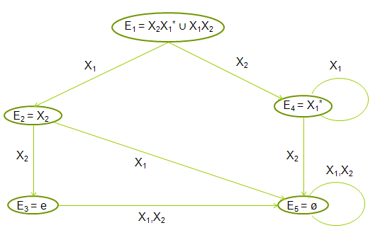
Example of designing PMG from Event Expression
Language is given E₁ = (X₂X₁* ∪ X₁X₂).
Applying the left-side-derivative with respect to first character in string, X₁
  E₁/X₁ = (X₂X₁* ∪ X₁X₂)/X₁
  = (X₂X₁*)/X₁ ∪ (X₁X₂)/X₁
  by P2
  = (X₂/X₁)X₁* ∪ ∈ (X₂)X₁* ∪ (X₁/X₁)/X₂ ∪ ∈ (X₁)(X₂/X₁)
  by P4
  = ø X₁ ∪ ø(X₁/X₂) ∪ eX₂ ∪ ø ø
  by P1
  = X₂

Slide 45
Fig. 2. Graph for regular language
E₁ = (X₂X₁* ∪ X₁X₂).
It can be interpreted as PMG, EEAM or BM depending on meaning of symbols X_{i}

Slide 46
Acceptor, generator and transformer
Observe that this graph can be interpreted as an acceptor, when symbols Xi are inputs.
It can be interpreted as a generator when symbols Xi are outputs.
The graph can be thus used to recognize if some motion belongs to some language and can generate a motion belonging to the language.
This graph is realized in software

Slide 47
Behavior Problems = examples of correct motions – generalize and modify, interpolate
Input text
Output text
Hexapod walking
Distance evaluation
Biped walking
Number of falls
evaluation
Biped Gestures
Comparison to video evaluation
Hand gestures
Subjective human evaluation
Learning problems in Human-Robot Interaction – Motion Behavior (input/output) generation problems

